Slide 1
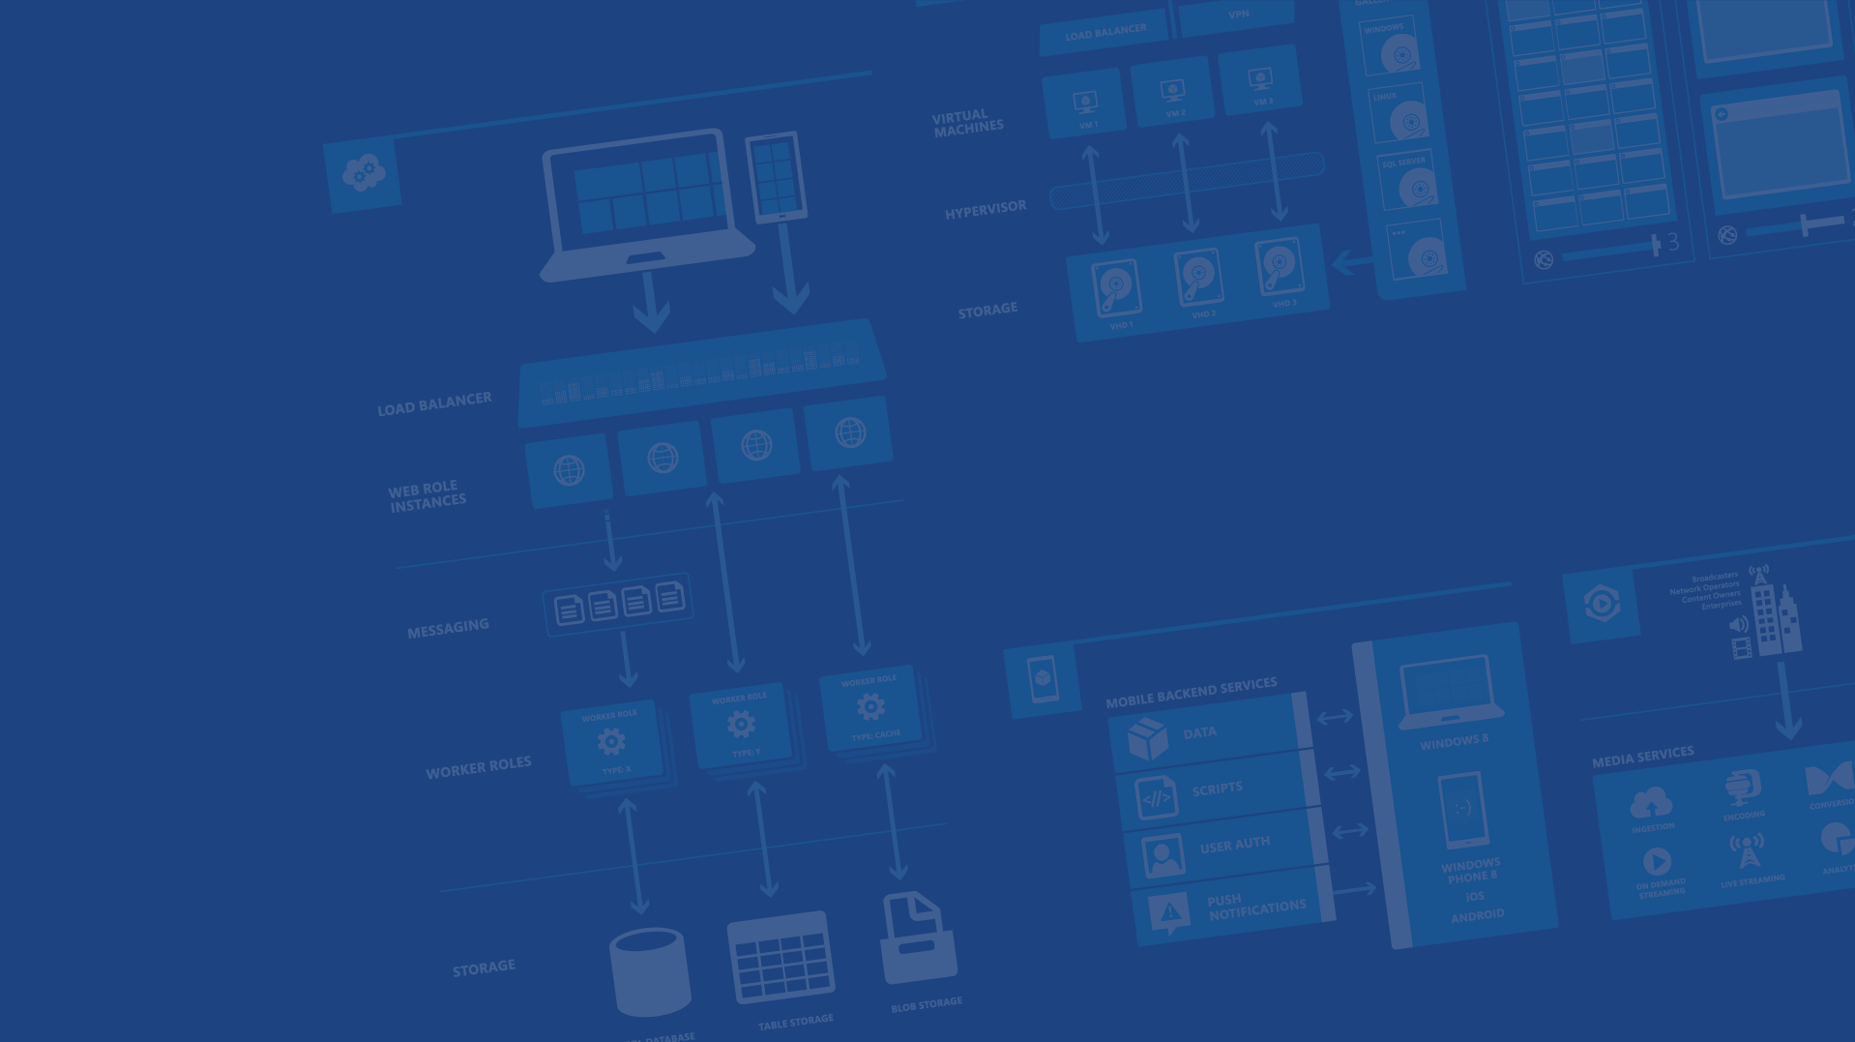
Azure App Service API APPS
Panos Tsilopoulos
Software Engineer
p.tsilopoulos@interworkscloud.com
https://gr.linkedin.com/in/panostsilopoulos
https://github.com/Tsilopoulos
Global Azure Bootcamp 2015

Slide 2
Agenda
Why Azure App Service (AAS)?
Platform Changes
What is AAS?
Developing API apps
Architecture & Lifecycle
Notes:
AAS = Azure App Service

Slide 3


Apps using Microsoft Azure
Hyper-scale
Agility
Insight
Notes:
Advantages gained by an app using AAS
Επεκτασιμότητα (Scalability) -> plus many many different ways/types to handle payments
Ευελιξία (Agility -> Minimum downtime/Easy(visual no CLI) deployment tools/Γεωμετρικά κατανεμημένοι πόροι
Τηλεμετρία/Ανάλυση δεδομένων της εφαρμογής σε πραγματικό χρόνο

Slide 4

Typical Usage Pattern

Slide 5

Typical Usage Pattern
TRADITIONAL COMPUTE DEPLOYMENT
Unused compute capacity

Slide 6

Typical Usage Pattern
AUTO SCALED COMPUTE CAPACITY

Slide 7

Introducing Azure App Service
Unique integrated offering
Build intelligent web and mobile apps
Scale as your business grows
Azure Websites
Mobile Services
BizTalk Services
Key app services in Azure today
Notes:
Today we are announcing App Service, a new service in Azure, which brings together the functionality of Azure Websites, Azure Mobile Services, and Azure Biztalk Services into a single development experience.

Slide 8

One integrated offering
Web Apps
Mobile Apps
Web apps that scale with your business
Build Mobile apps for any device
LOGIC Apps
Api Apps
Automate business process across SaaS and on-premises
Easily build and consume APIs in the cloud
Notes:
App Service has everything you need to build apps that target both web and mobile clients from a single app back-end.
Using API Apps, you can connect your app to dozens of popular services like Office 365 and salesforce.com in minutes, and integrate your own APIs so they can be used within any app.
And finally with Logic Apps, you can automate business processes using a simple no-code experience.

Slide 9
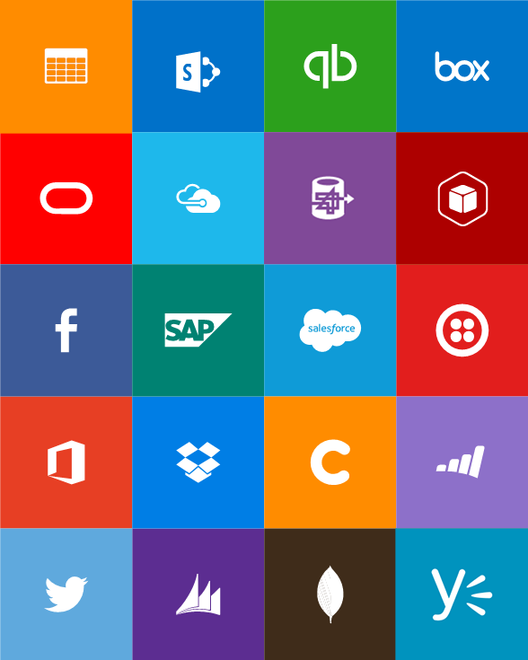
Built-in API Connectors
Connectors
Box
Chatter
Delay
Dropbox
Azure HD Insight
Marketo
Azure Media Services
OneDrive
SharePoint
SQL Server
Office 365
Oracle
QuickBooks
SalesForce
Sugar CRM
SAP
Azure Service Bus
Azure Storage
Timer / Recurrence
Twilio
Twitter
IBM DB2
Informix
Websphere MQ
Azure Web Jobs
Yammer
Dynamics CRM
Dynamics AX
Hybrid Connectivity
Protocols
BizTalk Services
HTTP, HTTPS
File
Flat File
FTP, SFTP
POP3/IMAP
SMTP
SOAP + WCF
Batching / Debatching
Validate
Extract (XPath)
Transform (+Mapper)
Convert (XML-JSON)
Convert (XML-FF)
X12
EDIFACT
AS2
TPMOM
Rules Engine
Notes:
All the connectivity and tools you need to automate your modern business – with over 40 connectors and growing all the time with the ability for any 3rd party to contribute to our gallery.

Slide 10
What is Azure App Service?
New application development platform based on existing proven Azure technologies
WebSites == WebApps
Mobile Services == Mobile Apps
NEW – API Apps
NEW – Logic Apps

Slide 11
Common needs
Reusable components
Easy discovery and distribution
Easily replaceable without breaking the solution
Like replacing a tire on a car
Independently scalable units
E.g. E-mail service vs database module
Lifecycle management
Deployment
Updates
Monitoring

Slide 12
Monolithic architecture
Server
Server
Server
Server
Server
Server

Slide 13

Monolithic architecture
Application Database
Blob Storage
Microsoft Azure
Load Balancer
Server
Redis
Server

Slide 14
Monolithic issues
Scaling
N:1 mapping on roles. Resources wasted
1:1 mapping on roles. Expensive, resources wasted.
Deployment takes time
Manual updates of components
App and project oriented

Slide 15
Microservice architecture
Server
Server
Server
Server
Server
Server

Slide 16
Microservice architecture
Application Database
Server
Blob Storage
Microsoft Azure
Load Balancer
Redis

Slide 17
Microservice benefits
Scaling
Services scale independently
Fast deployments
Control over component updates
Business functionality oriented e.g.:
Send e-mails
Database CRUD
Payments

Slide 18
Azure App Service
API Apps in detail

Slide 19
What’s new? API Apps!
Build, deploy and consume APIs
API App is 1:1 mapping to a Web App
Extra metadata
Two forms
Code API Apps
Codeless API Apps*
Distributed through feeds aka galleries*
Public or private

Slide 20
API Apps – In detail
Deployed into an RG
Exposed through a gateway
Automatic or manual updates
Mix and match App Hosting Plans
Different SKUs within the same RG
ARM template can be customized*
You can deploy dependencies, jobs etc.
Notes:
SKUs such us free/basic/standard/shared/premium
ARM stands for Azure Resource Management template

Slide 21
Building Code API Apps
MVC Web API or other any technology
Swagger 2.0 for metadata
Visual Studio experience
Build, Package*, Deploy

Slide 22
Let’s build a code API App
Demo

Slide 23
What did we do?
Created an API App using the template
This can also be any other technology
Change some (simple) code
App Service SDK is already present
Swashbuckle (Swagger Metadata 2.0)
Some required metadata files
Deployed to the API App container

Slide 24
Swashbuckling made simple
Swagger is a standard, language-agnostic interface to REST APIs which allows both humans and computers to discover and understand the capabilities of the service without access to source code, documentation, or through network traffic inspection.
A small ISS Express hiccup!
Run cmd.exe
cd “C:\Program Files\IIS Express”
.\appcmd set config /section:directoryBrowse /enabled:true
SwaggerConfig.cs
EnableSwaggerUI

Slide 25
Let’s consume the API App
Demo

Slide 26
Generating the SDK
Created a simple console app
Added the API App Client
It generated the SDK/library for us
Called the API using strongly typed code ☺

Slide 27
Authentication
Multiple Identity providers supported
Authentication is done at the gateway
You get a token on your App Service Apps
IdPs supported:
AAD
MSA
Facebook
Twitter
Google
API Apps can be:
Internal
Public Anonymous
Public Authenticated
Notes:
AAD = Azure Active Directory
MSA = Microsoft Account

Slide 28
Summary of features
Available now:
Seamless authentication
API definition and code generation in Visual Studio
Integration with Logic Apps
Coming in the near future:
Galleries (marketplace)
Packaging and dependencies with ARM templates
API management
Codeless API Apps

Slide 29
API App Architecture

Slide 30



Scale unit
RG
AZ LB
Git
Gateway App
Private
API Management
Authentication
Visual Studio
Feed/Gallery
Public
GitHub
Azure Services
Portal
Notes:
AZ LB = Azure Load Balancer

Slide 31
Next steps
Grab the bits
Start developing
Feedback!

Slide 32
References, resources & repository
http://www.kefalidis.me/category/azure-app-service/
https://azure.microsoft.com/en-us/documentation/videos/azure-app-service-api-apps-with-scott-hunter/
http://www.microsoftvirtualacademy.com/product-training/microsoft-azure
https://azure.microsoft.com/en-us/documentation/articles/app-service-api-apps-why-best-platform/
http://swagger.io/
https://github.com/ThessalonikiNet-MeetUp/globalazurebootcamp2015

